Slide 1
Process Description & Control
Covers Chapter#03 from Textbook

Slide 2
Process and Process Control Block
The most central concept in any operating system is the process.
All multiprogramming operating systems are built around the concept of the process (including mainframe computers).
At any given point in time, a process can be uniquely characterized by a number of elements, including:
Identifier: A unique ID associated with the process.
State: If process is currently executing, it is in the “running state”.
Priority: Priority level relative to other processes.
Program counter: Address of next instruction to be executed.

Slide 3
Process and Process Control Block (Cont.)
Memory pointers: Pointers to the program code, data associated with process and any memory blocks shared with other processes.
Context data: Data that are present in registers in the processor while the process is executing.
I/O status information: Outstanding I/O requests, I/O devices assigned to this process, etc.
Accounting information: The amount of processor time and clock time used, time limits and account numbers, etc.
These above information is stored in a data structure, called a process control block (PCB), created and managed by the OS.

Slide 4
Process and Process Control Block (Cont.)
Benefits of using PCB:
Possible to interrupt a running process and later resume execution as if the interruption had not occurred.
Key tool that allows support for multiple processes.

Slide 5
Process States
Process trace: listing the sequence of instructions that execute for that process.
Behavior of the processor can be characterize by showing how the traces of the various processes are interleaved.
Dispatcher: a small program that switches the processor from one process to another.

Slide 6
Process States (Cont.)
Example of a three processes that are fully loaded in main memory (i.e. no virtual memory):
The first 12 instructions executed in processes A and C.
Process B executes four instructions and the fourth instruction invokes an I/O operation for which the process must wait.
We assume that OS only allows a process to continue execution for a maximum of 6 instruction cycles.
The same sequence of instructions is executed by dispatcher in each instance which executes 6 instructions, starting from 100 – 105.

Slide 8
Process States (Cont.)
From the processor’s point of view, the interleaved traces resulting from the first 52 instruction cycles is shown in the Figure.
Shaded areas represent code executed by dispatcher.

Slide 9
Process Creation
Common events that lead to the creation of a process:
System initialization: when an operating system is booted, typically numerous processes are created.
Daemons: processes that stay in the background to handle some activity.
New batch job: process is created in response to submission of a job (usually found on mainframe computers).
Interactive log-on: a process is created when a new user attempts to log on.
Created by OS to provide a service: OS can create a process to perform a function on behalf of a user program (e.g., a process to control printing).
Spawned by existing process: one process to cause the creation of another. For purposes of modularity or to exploit parallelism.

Slide 10
Process Creation (Cont.)
Process spawning: the OS creates a process at the explicit request of another process.
When one process spawns another, the former is referred to as the parent process, and the spawned process is referred to as the child process.

Slide 11
Process Termination
Common events that lead to the termination of a process:
A batch job should include a Halt instruction for termination, which will generate an interrupt to alert the OS that a process has completed.
For an interactive application, the action of the user will indicate when the process is completed. E.g. the user logs off or turns off terminal.
A user may quit an application that would ultimately result in a service request to the OS to terminate the requesting process.
A process may be terminated by the process that created it or when the parent process is itself terminated.
Additionally, a number of error and fault conditions can lead to the termination of a process.

Slide 12
Two-State Process Model
The simplest possible model to control processes would be that at any time a process is either being executed by or not.
In the two-state model, a process may be in one of two states: Running or Not Running.

Slide 13
Two-State Process Model (Cont.)
When the OS creates a new process, it creates a PCB for the process and enters that process into the system in the Not Running state.
The process exists, i.e. it is known to the OS, and is waiting for an opportunity to execute.
From time to time, the currently running process will be interrupted and the dispatcher will select some other process to run.
The former process moves from Running state to Not Running state, and one of the other processes moves to Running state.

Slide 14
Two-State Process Model (Cont.)
Processes that are not running must be kept in some sort of queue, waiting their turn to execute.
There is a single queue in which each entry is a pointer to the PCB of a particular process.

Slide 15
Five-State Process Model
Limitations in Two-state model:
The two-state process model implementation is inadequate due to some processes in the Not Running state might be ready to execute while others might be blocked, e.g. waiting for an I/O operation to complete. Hence, dispatcher has to scan the list looking for the process that is not blocked and that has been in queue the longest.
The Not Running state is split into two states: Ready and Blocked.

Slide 16
Five-State Process Model (Cont.)
Fig. Five-State Process Model
Fig. Two-State Process Model

Slide 17
Five-State Process Model (Cont.)
Running: The process that is currently being executed.
Ready: A process prepared to execute when given the opportunity.
Blocked/Waiting: A process that cannot execute until some event occurs, such as completion of an I/O operation.
New: A process that has just been created but has not yet been admitted by the OS to the pool of executable processes. Typically, a new process has not yet been loaded into main memory.
Exit: A process that has been released from the pool of executable processes by the OS.

Slide 18
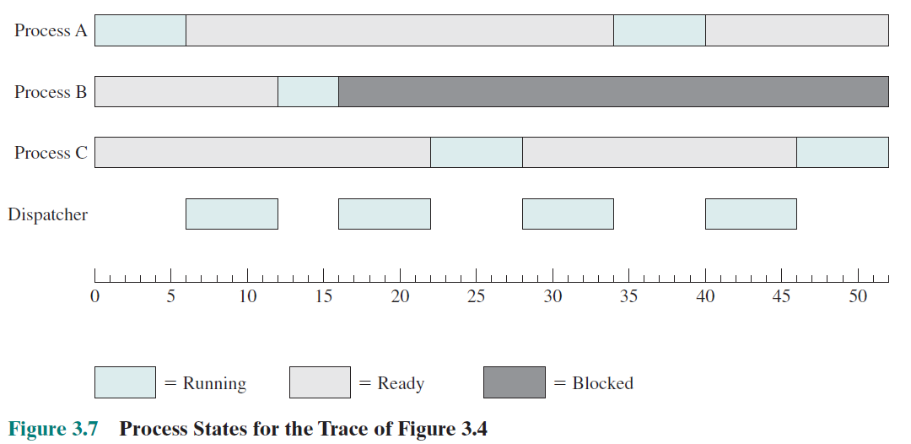
Five-State Process Model (Cont.)

Slide 19
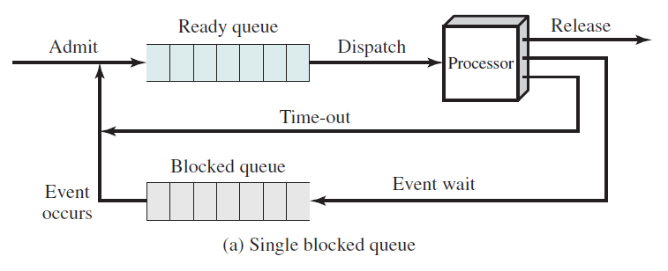
Five-State Process Model (Cont.)
Five-state model queue diagram:

Slide 20
Suspended Processes
The issue: the processor is so much faster than I/O that it will be common for all processes in memory to be waiting for I/O. Thus, even with multiprogramming, a processor could be idle most of the time → Solution is swapping.
Swapping: moving part or all of a process from main memory to disk into a suspend queue when none of the processes in main memory is in the Ready state.
The disk would contain a queue of existing processes that have been temporarily kicked out of main memory, or suspended.
The OS brings in another process from the suspend queue or it honors a new-process request.

Slide 21
Suspended Processes (Cont.)
Fig. Process State Transition Diagram with Suspend States

Slide 22
Thank You!

